Slide 1
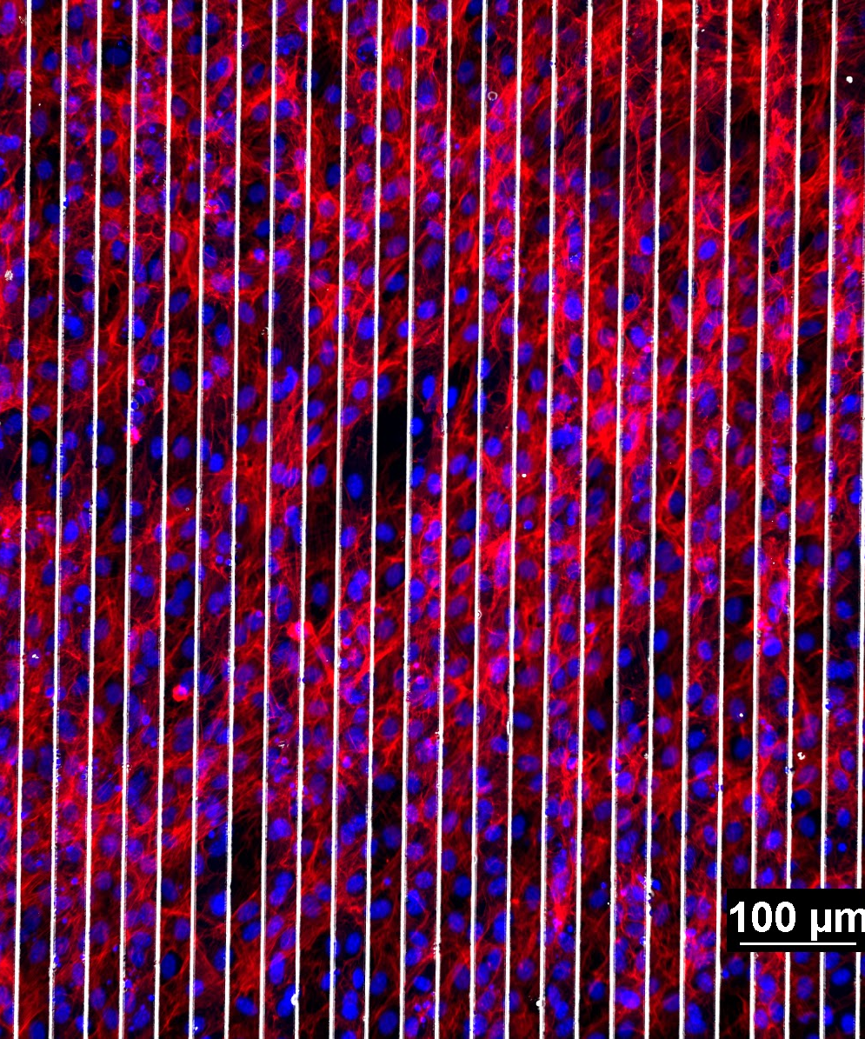
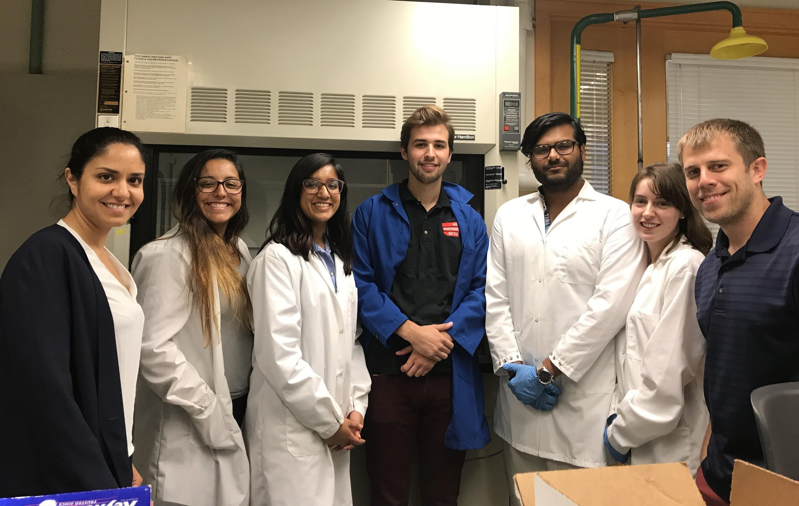
Engineering Aligned, Bioactive Polymers for Peripheral Nerve Repair
University of Cincinnati RET 2019-2020
Megan Brown and Akshayaa Venkatakrishnan
Dr. Greg Harris and Dr. Leyla Esfandiari
Project 1
Notes:
AV

Slide 2
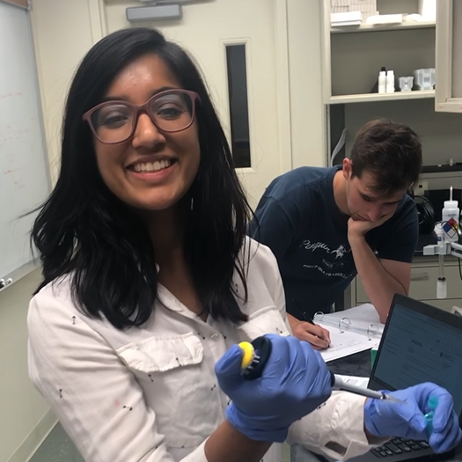
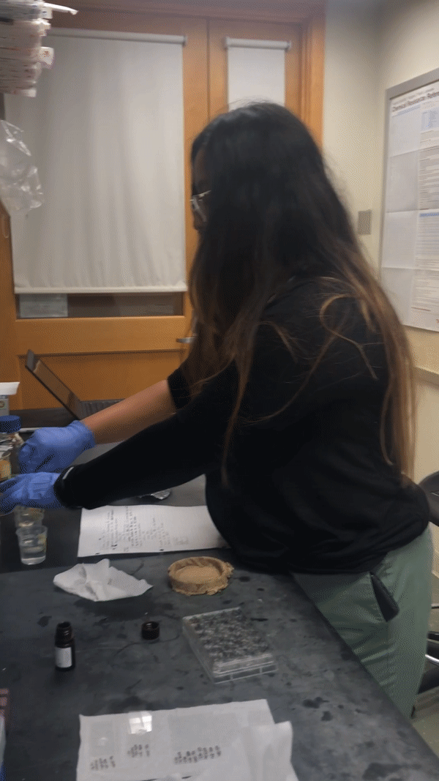
Megan Brown
High School Science
Newport High School
Newport, KY
Akshayaa Venkatakrishnan
High School Science
Dater High School
Cincinnati, OH

Slide 3
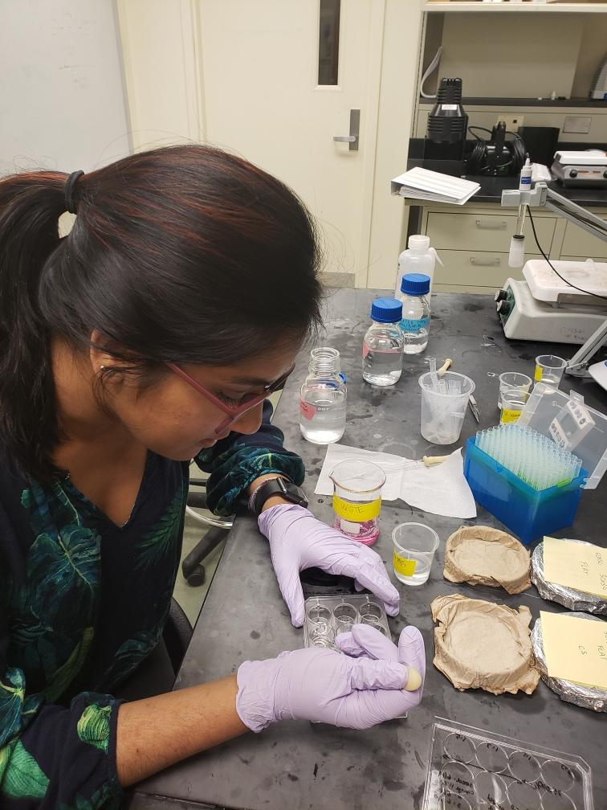
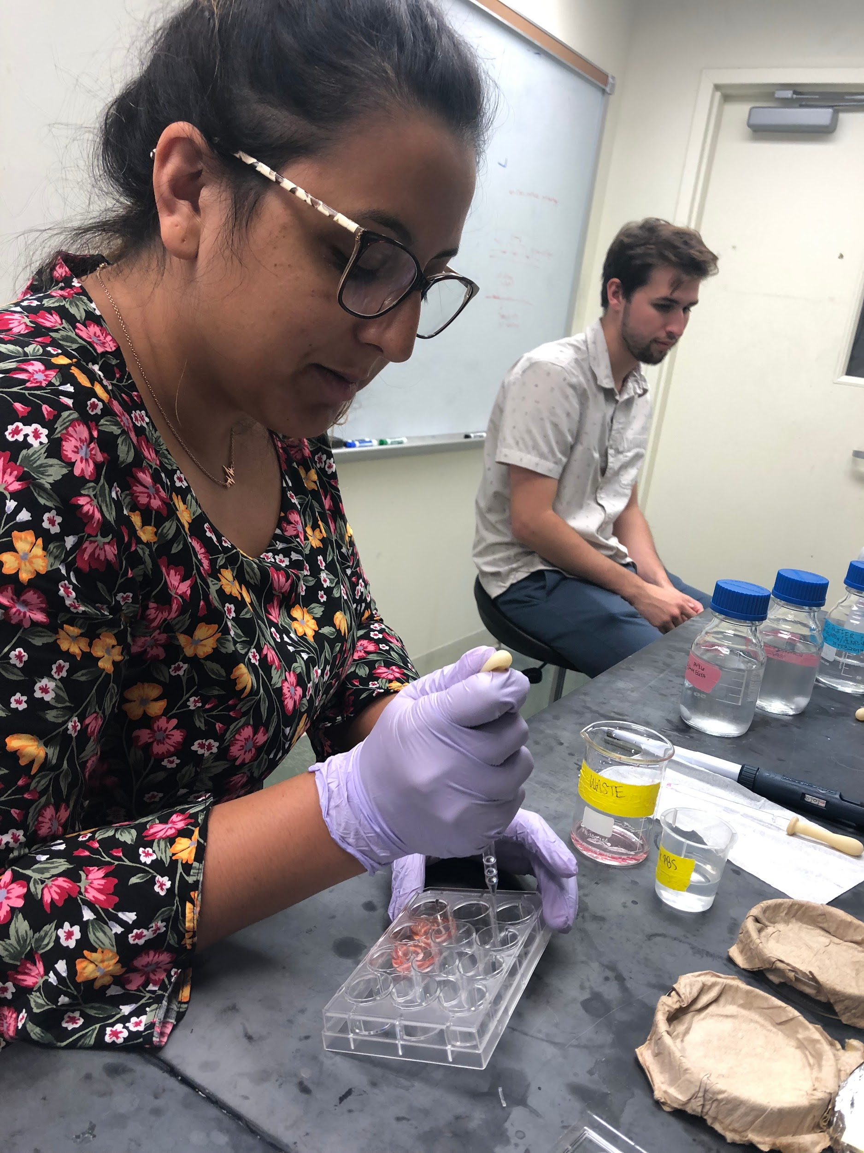
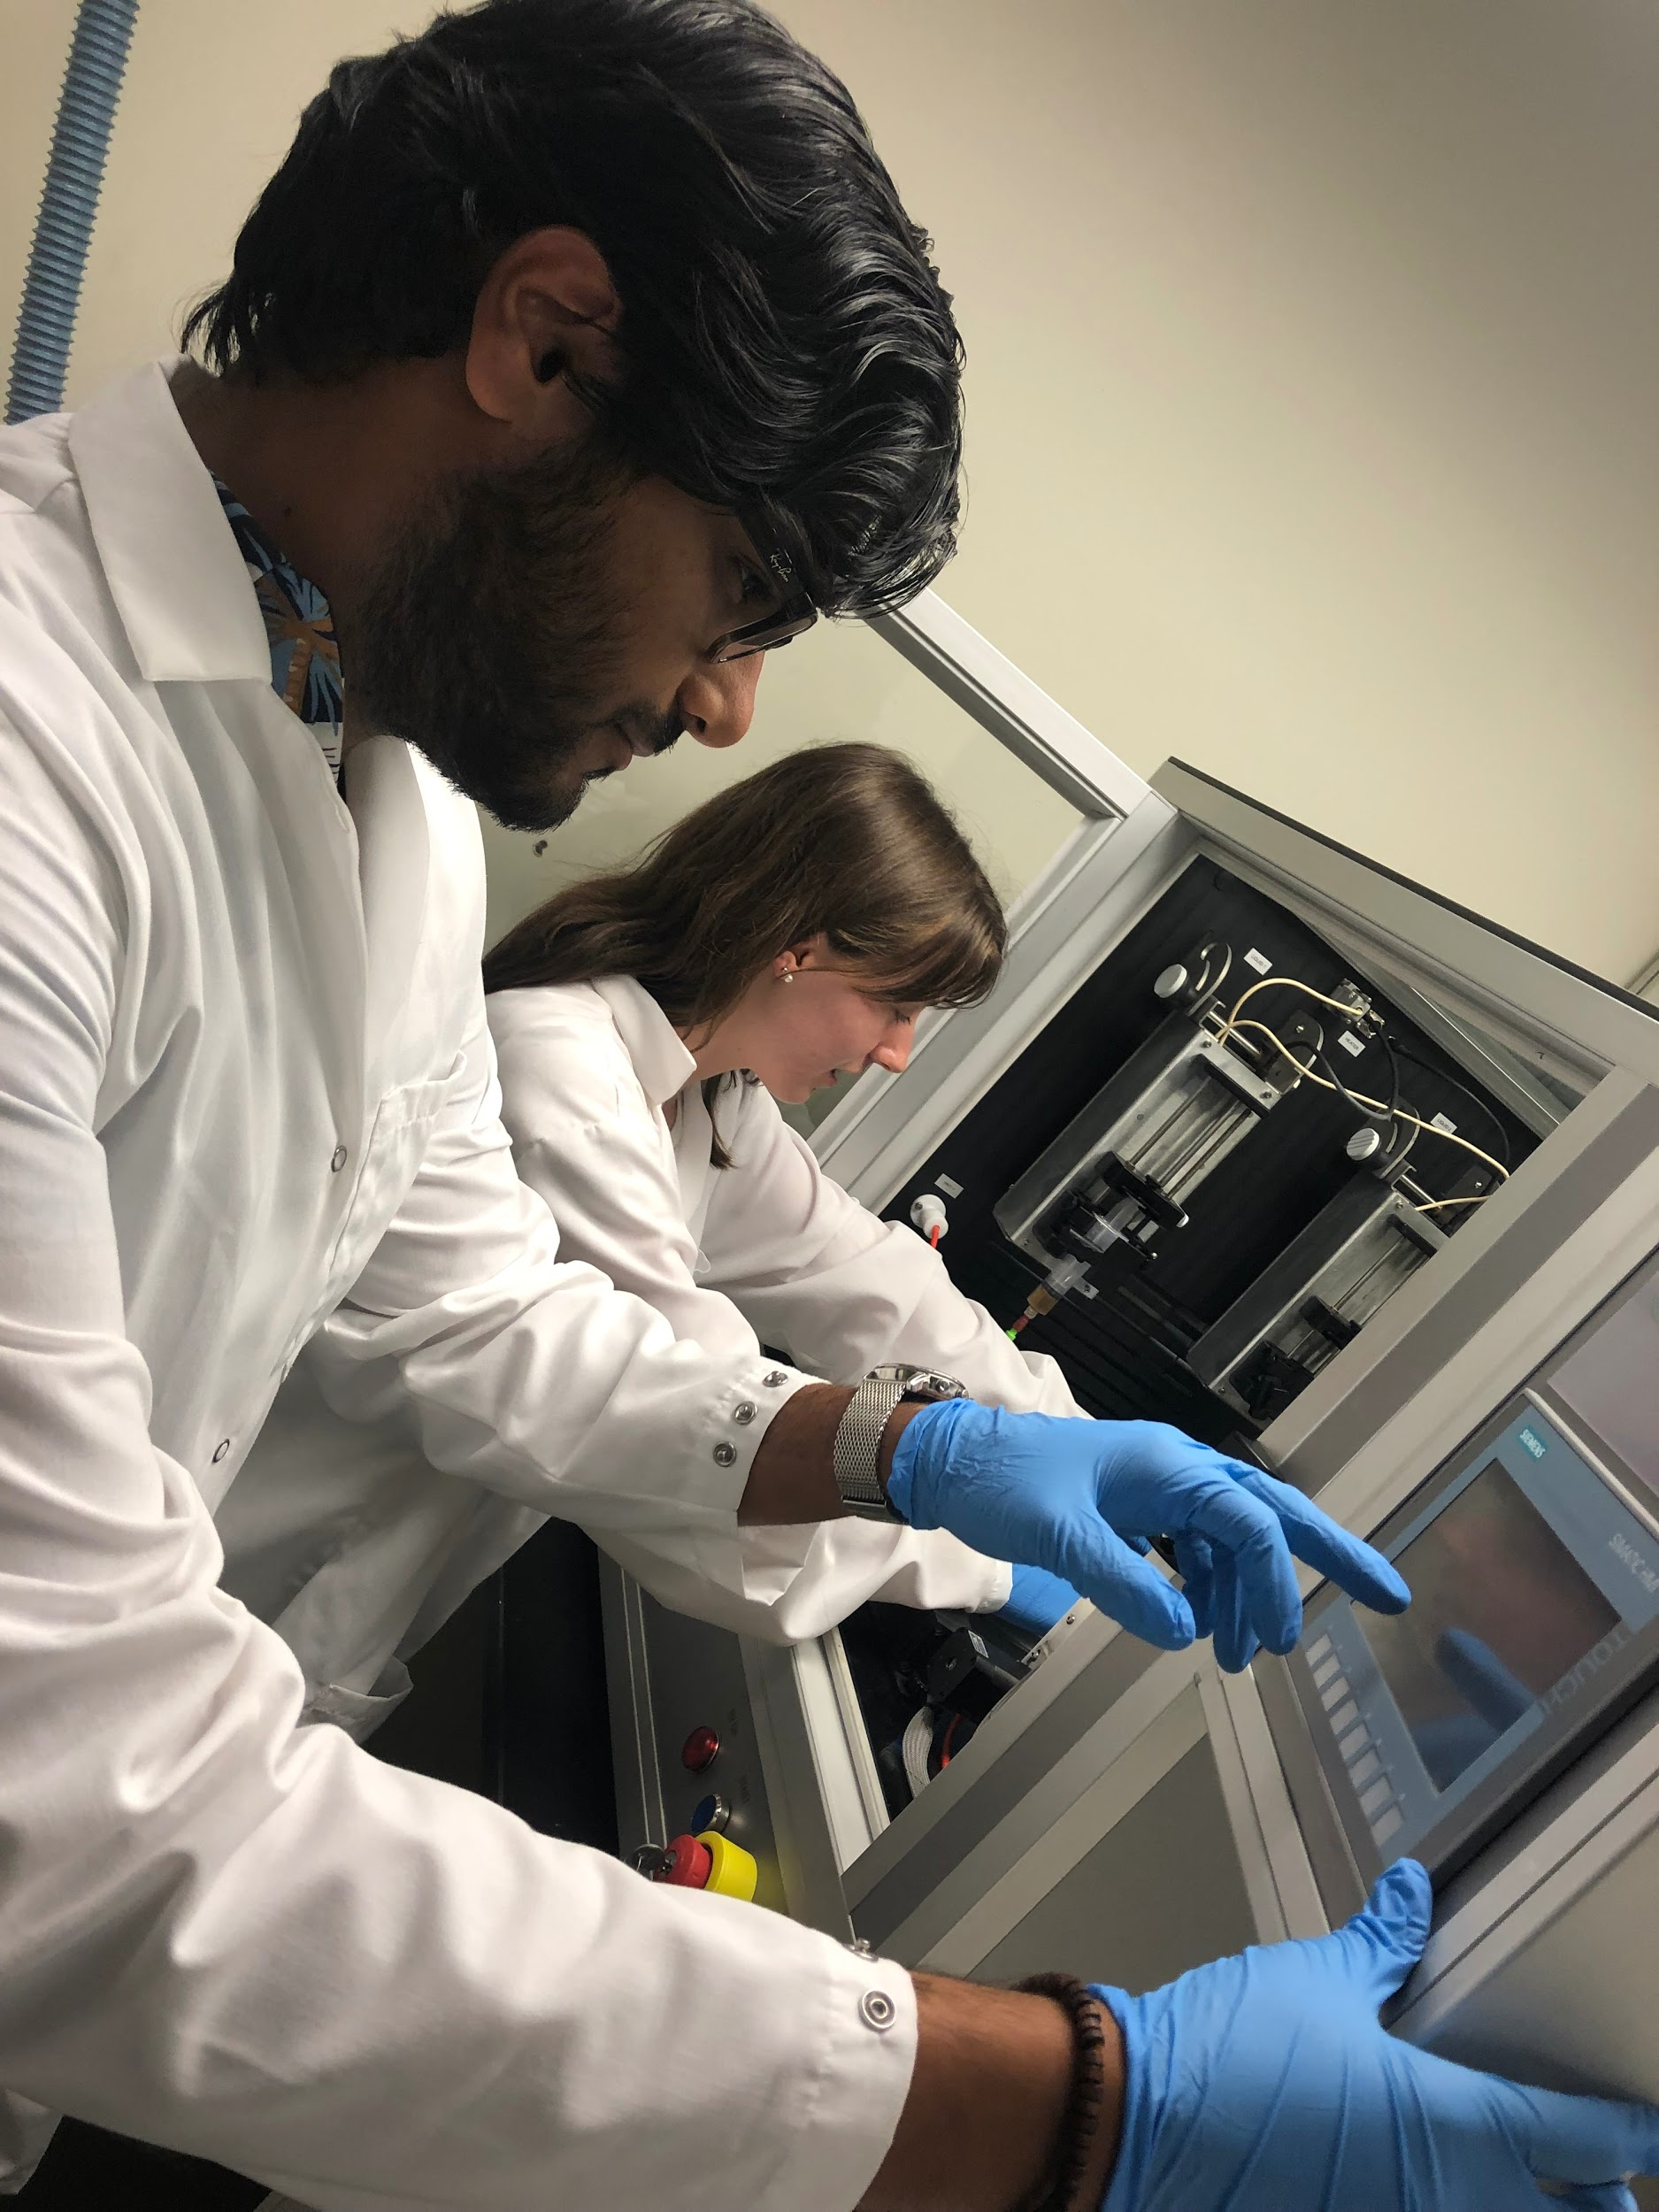
Table of Contents
Background
Research
Classroom Implementation Plans
Notes:
MB

Slide 4
Background
1
Introduction, Abstract, Literature Review

Slide 5
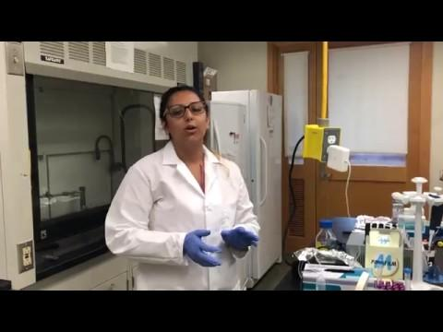

Slide 6
Peripheral nerves send vital sensory information throughout your body.
Over 20 million Americans suffer from peripheral nerve injury.
The leading cause of peripheral nerve damage in the United States in diabetes.
Most clinical treatments involve handling the symptoms of nerve damage, and not regenerating the damaged cells themselves.
Did you know...
Peripheral Neuropathy Fact Sheet. (n.d.). Retrieved from https://www.ninds.nih.gov/Disorders/Patient-Caregiver-Education/Fact-Sheets/Peripheral-Neuropathy-Fact-Sheet
Notes:
MB Film

Slide 7
Did you know...
Peripheral nerves send vital sensory information throughout your body.
Peripheral Neuropathy Fact Sheet. (n.d.). Retrieved from https://www.ninds.nih.gov/Disorders/Patient-Caregiver-Education/Fact-Sheets/Peripheral-Neuropathy-Fact-Sheet
Notes:
MB Film

Slide 8
If I touched this hot plate, my nerves would send a signal to my brain that I was causing harm to my body

Slide 9
Over 20 million Americans suffer from peripheral nerve injury.
The leading cause of peripheral nerve damage in the United States is diabetes.

Slide 10
Most clinical treatments involve handling the symptoms of nerve damage, and not regenerating the damaged cells themselves.

Slide 11
In Dr. Harris’ and Dr. Esfandiari’s labs, we are working on tissue engineering to improve cell regeneration and nerve repair.

Slide 12
What is tissue engineering?
“The goal of tissue engineering is to assemble functional constructs that restore, maintain, or improve damaged tissues or whole organs.”
Tissue Engineering and Regenerative Medicine. (n.d.). Retrieved 17 July 2019. Retrieved from https://www.nibib.nih.gov/science-education/science-topics/tissue-engineering-and-regenerative-medicine
Notes:
Combine w previous

Slide 13
By aligning cells using piezoelectric, biocompatible scaffolds, we can engineer clinical solutions for damaged cells.

Slide 14
In this presentation, we’ll tell you more about how this research can impact the future of tissue engineering.

Slide 15
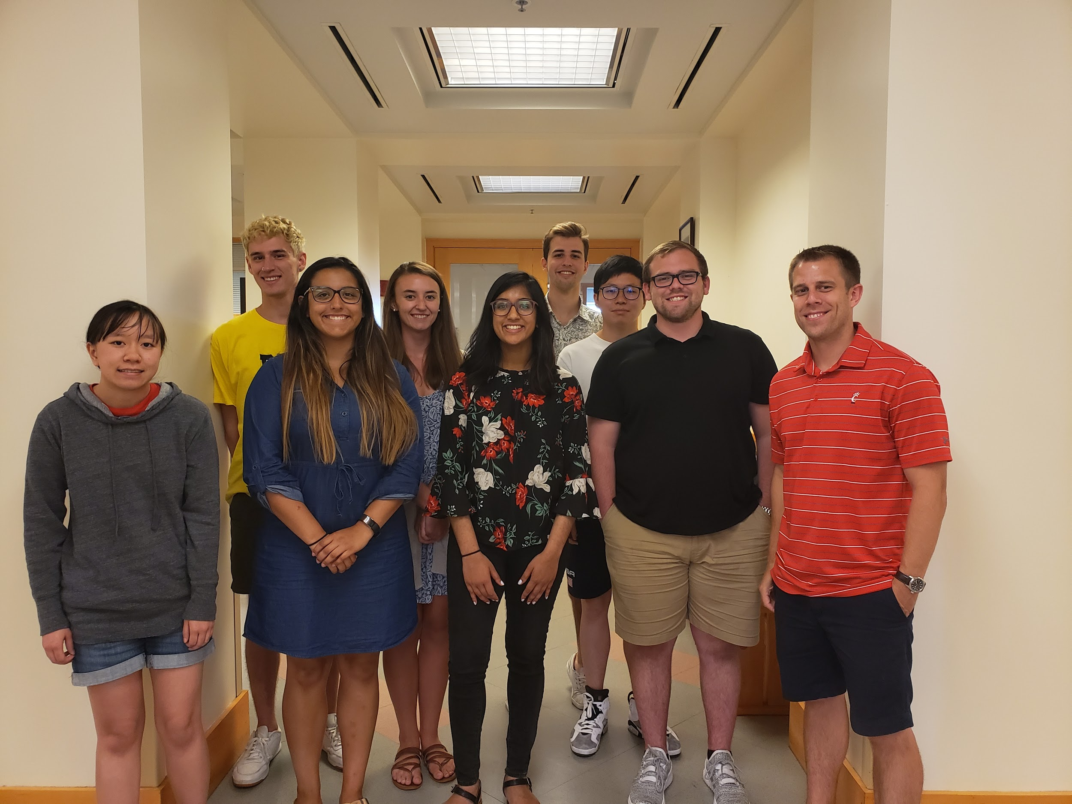
Summer Research Goal
Identify the role of piezoelectric, biocompatible scaffolds in cell alignment and growth.

Slide 16
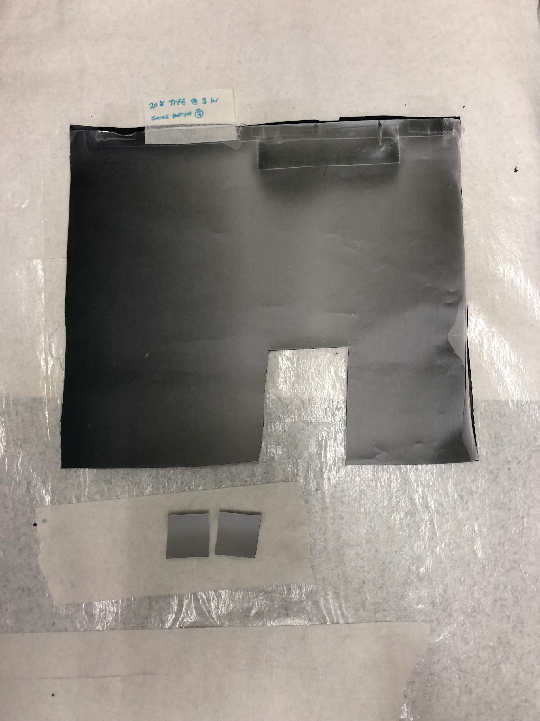
Abstract
The goal of this research is to determine the optimal conditions of a piezoelectric, bioactive scaffold that will create the most aligned tissue when cells are seeded on it.
+
Notes:
AV

Slide 17
Abstract
The goal of this research is to determine the optimal conditions of a piezoelectric, bioactive scaffold that will create the most aligned tissue when cells are seeded on it.
+
Notes:
AV

Slide 18
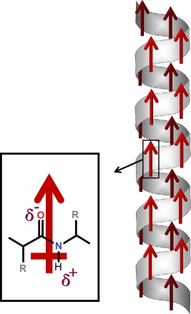
What is piezoelectricity?
A property of certain biological tissues and their protein structures that cause an electric field to be formed in the tissue due to mechanical stress.
This electric field that is created leads to the regeneration of these types of tissue.
Figure 1: Alpha Helix structure of a piezoelectric material.
Photo Citation:
(2015, September 15). Piezoelectric materials for tissue regeneration: A review - ScienceDirect. Retrieved June 24, 2019, from https://www.sciencedirect.com/science/article/pii/S1742706115300167
Notes:
MB
(2015, September 15). Piezoelectric materials for tissue regeneration: A review - ScienceDirect. Retrieved June 24, 2019, from https://www.sciencedirect.com/science/article/pii/S1742706115300167

Slide 19
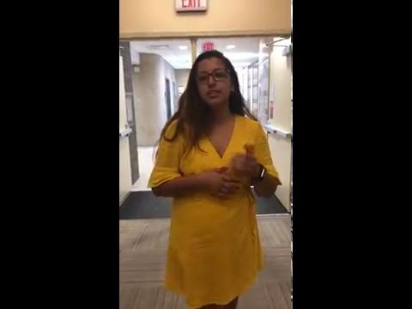

Slide 20
How does piezoelectricity affect our body?
Tennis player swings same spot repetitively
Mechanical stress applied in one spot
Deformation in electric field sends signal to the cells.
Cues are sent to initiate signaling pathway to begin regeneration.
(2019, January 15). Retrieved June 26, 2019, from https://encrypted-tbn0.gstatic.com/images?q=tbn:ANd9GcR6j0aP1a11_pq7gZRlAuajrobOjMGoSrN4BdSY2m0mmcnSahrVXw
Notes:
MB

Slide 21
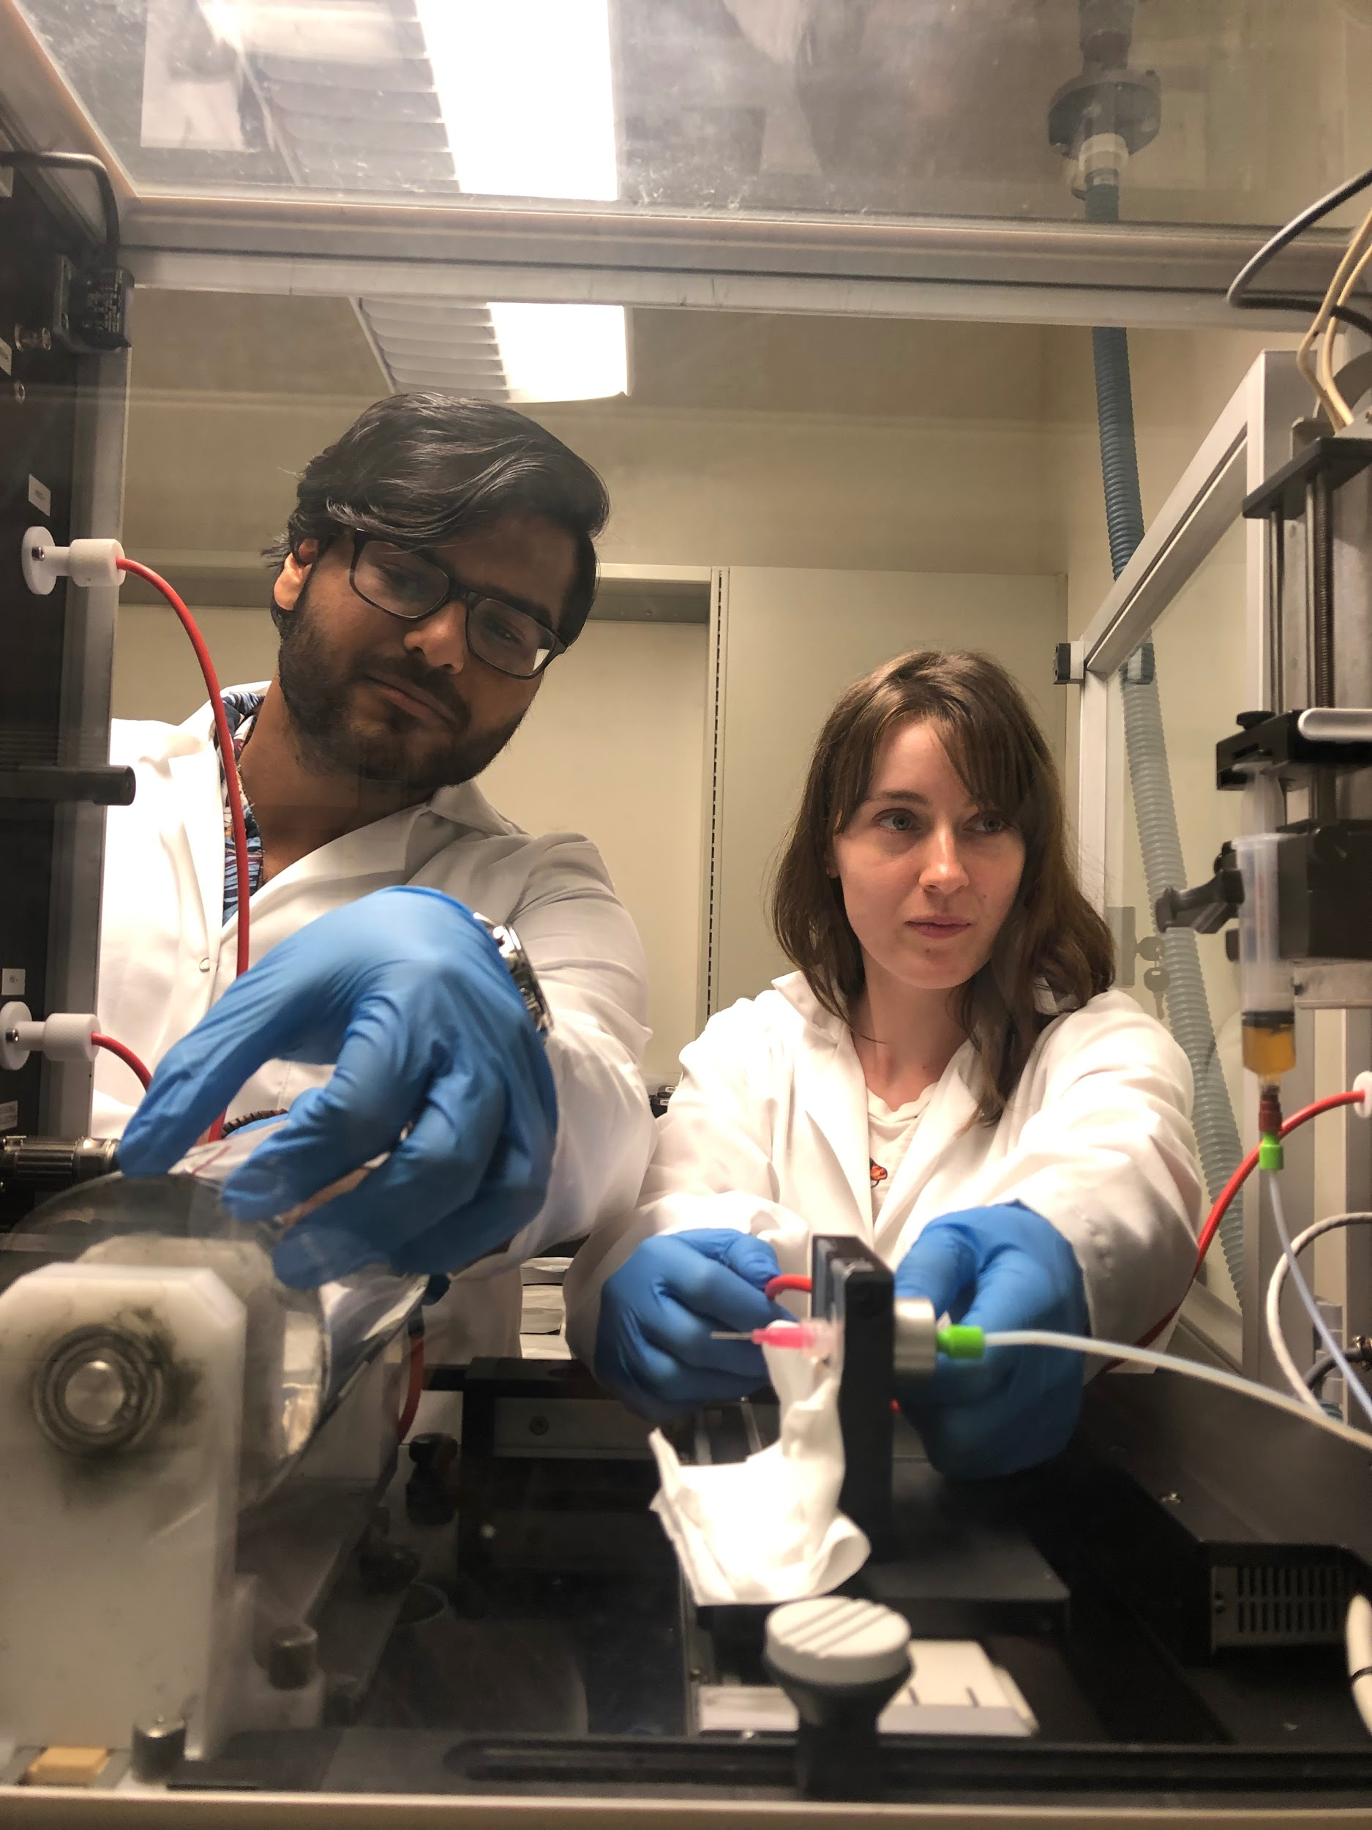
Why is piezoelectricity important?
Plays a crucial role in:
bone formation
embryonic development
wound healing
neural regeneration
Without piezoelectricity:
Important connective tissues would not regenerate from the stress of day-to-day activity
Notes:
AV
Rajabi, A.H., Jaffe, M., Arinzeh,
L.T. (2015). Piezoelectric
materials for tissue
regeneration: a review. Acto
biomaterialia, 24, 12-23.

Slide 22
In school, we learn about what’s inside the cell.
Have you ever thought about…
what’s outside of them?

Slide 23
Extracellular matrix
Surrounds cells and connects them in a “web” to one another
Contains collagen, fibronectin, and other proteins that bind to create structure for the cells
Extracellular Matrix. (n.d.). Retrieved June 26, 2019, from https://www.khanacademy.org/science/biology/structure-of-a-cell/cytoskeleton-junctions-and-extracellular-structures/a/the-extracellular-matrix-and-cell-wall

Slide 24
Research
2
Role and developments in current research

Slide 25
STEP 5
Evaluate success of different conditions
STEP 1
Grow cells on coverslips and decellularize ECM
Research Steps
STEP 4
Seed cells in different conditions
STEP 2
Characterize a polymer that is biocompatible and maximizes cell growth
STEP 3
Electrospin ECM into a biocompatible polymer
Notes:
AV

Slide 26
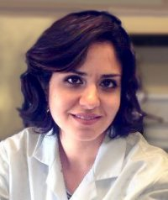
Dr. Harris’ Lab:
How can we decellularize ECM on/in the scaffold to support cell regeneration?
STEP 5
Evaluate success of scaffold + ECM
STEP 1
Create a scaffold that is biocompatible and maximizes cell growth
Research Steps
STEP 4
Test scaffold + ECM for cell growth and piezoelectric properties
STEP 2
Allow cells to grow on polymer surface and create a bioactive ECM
Dr. Esfandiari’s lab:
How might we create a piezoelectric and biocompatible scaffold?
STEP 3
Remove cells and keep the extracellular matrix
Notes:
AV

Slide 27
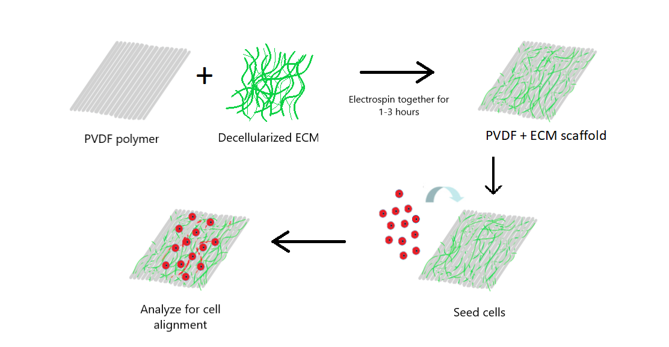
Step 1: Create a Robust ECM
Notes:
AV

Slide 28
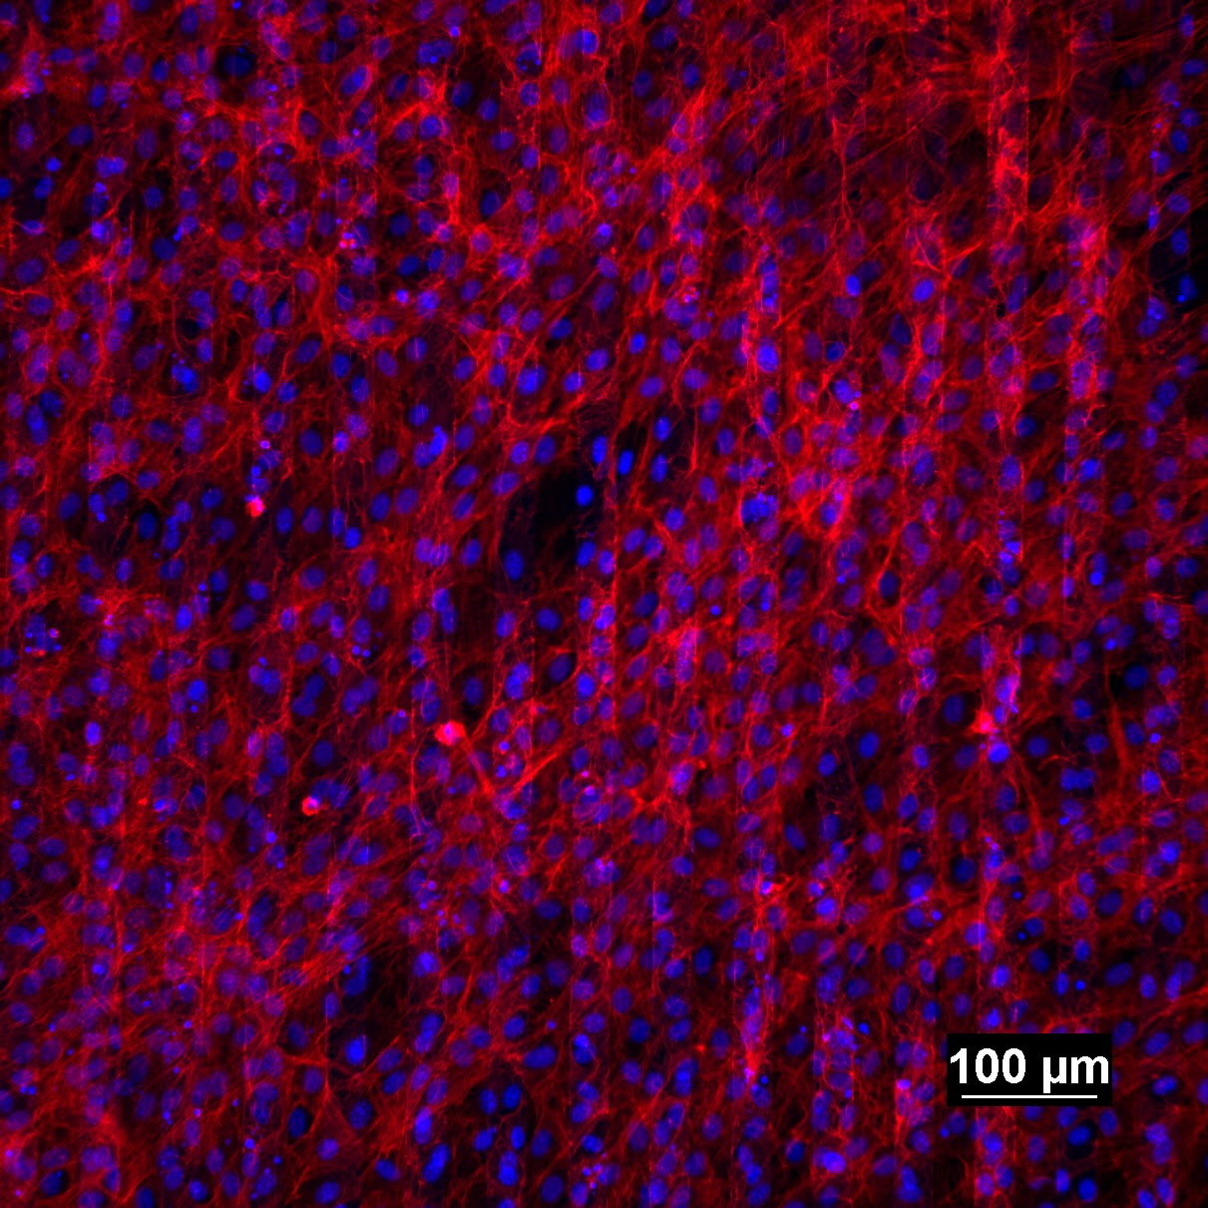
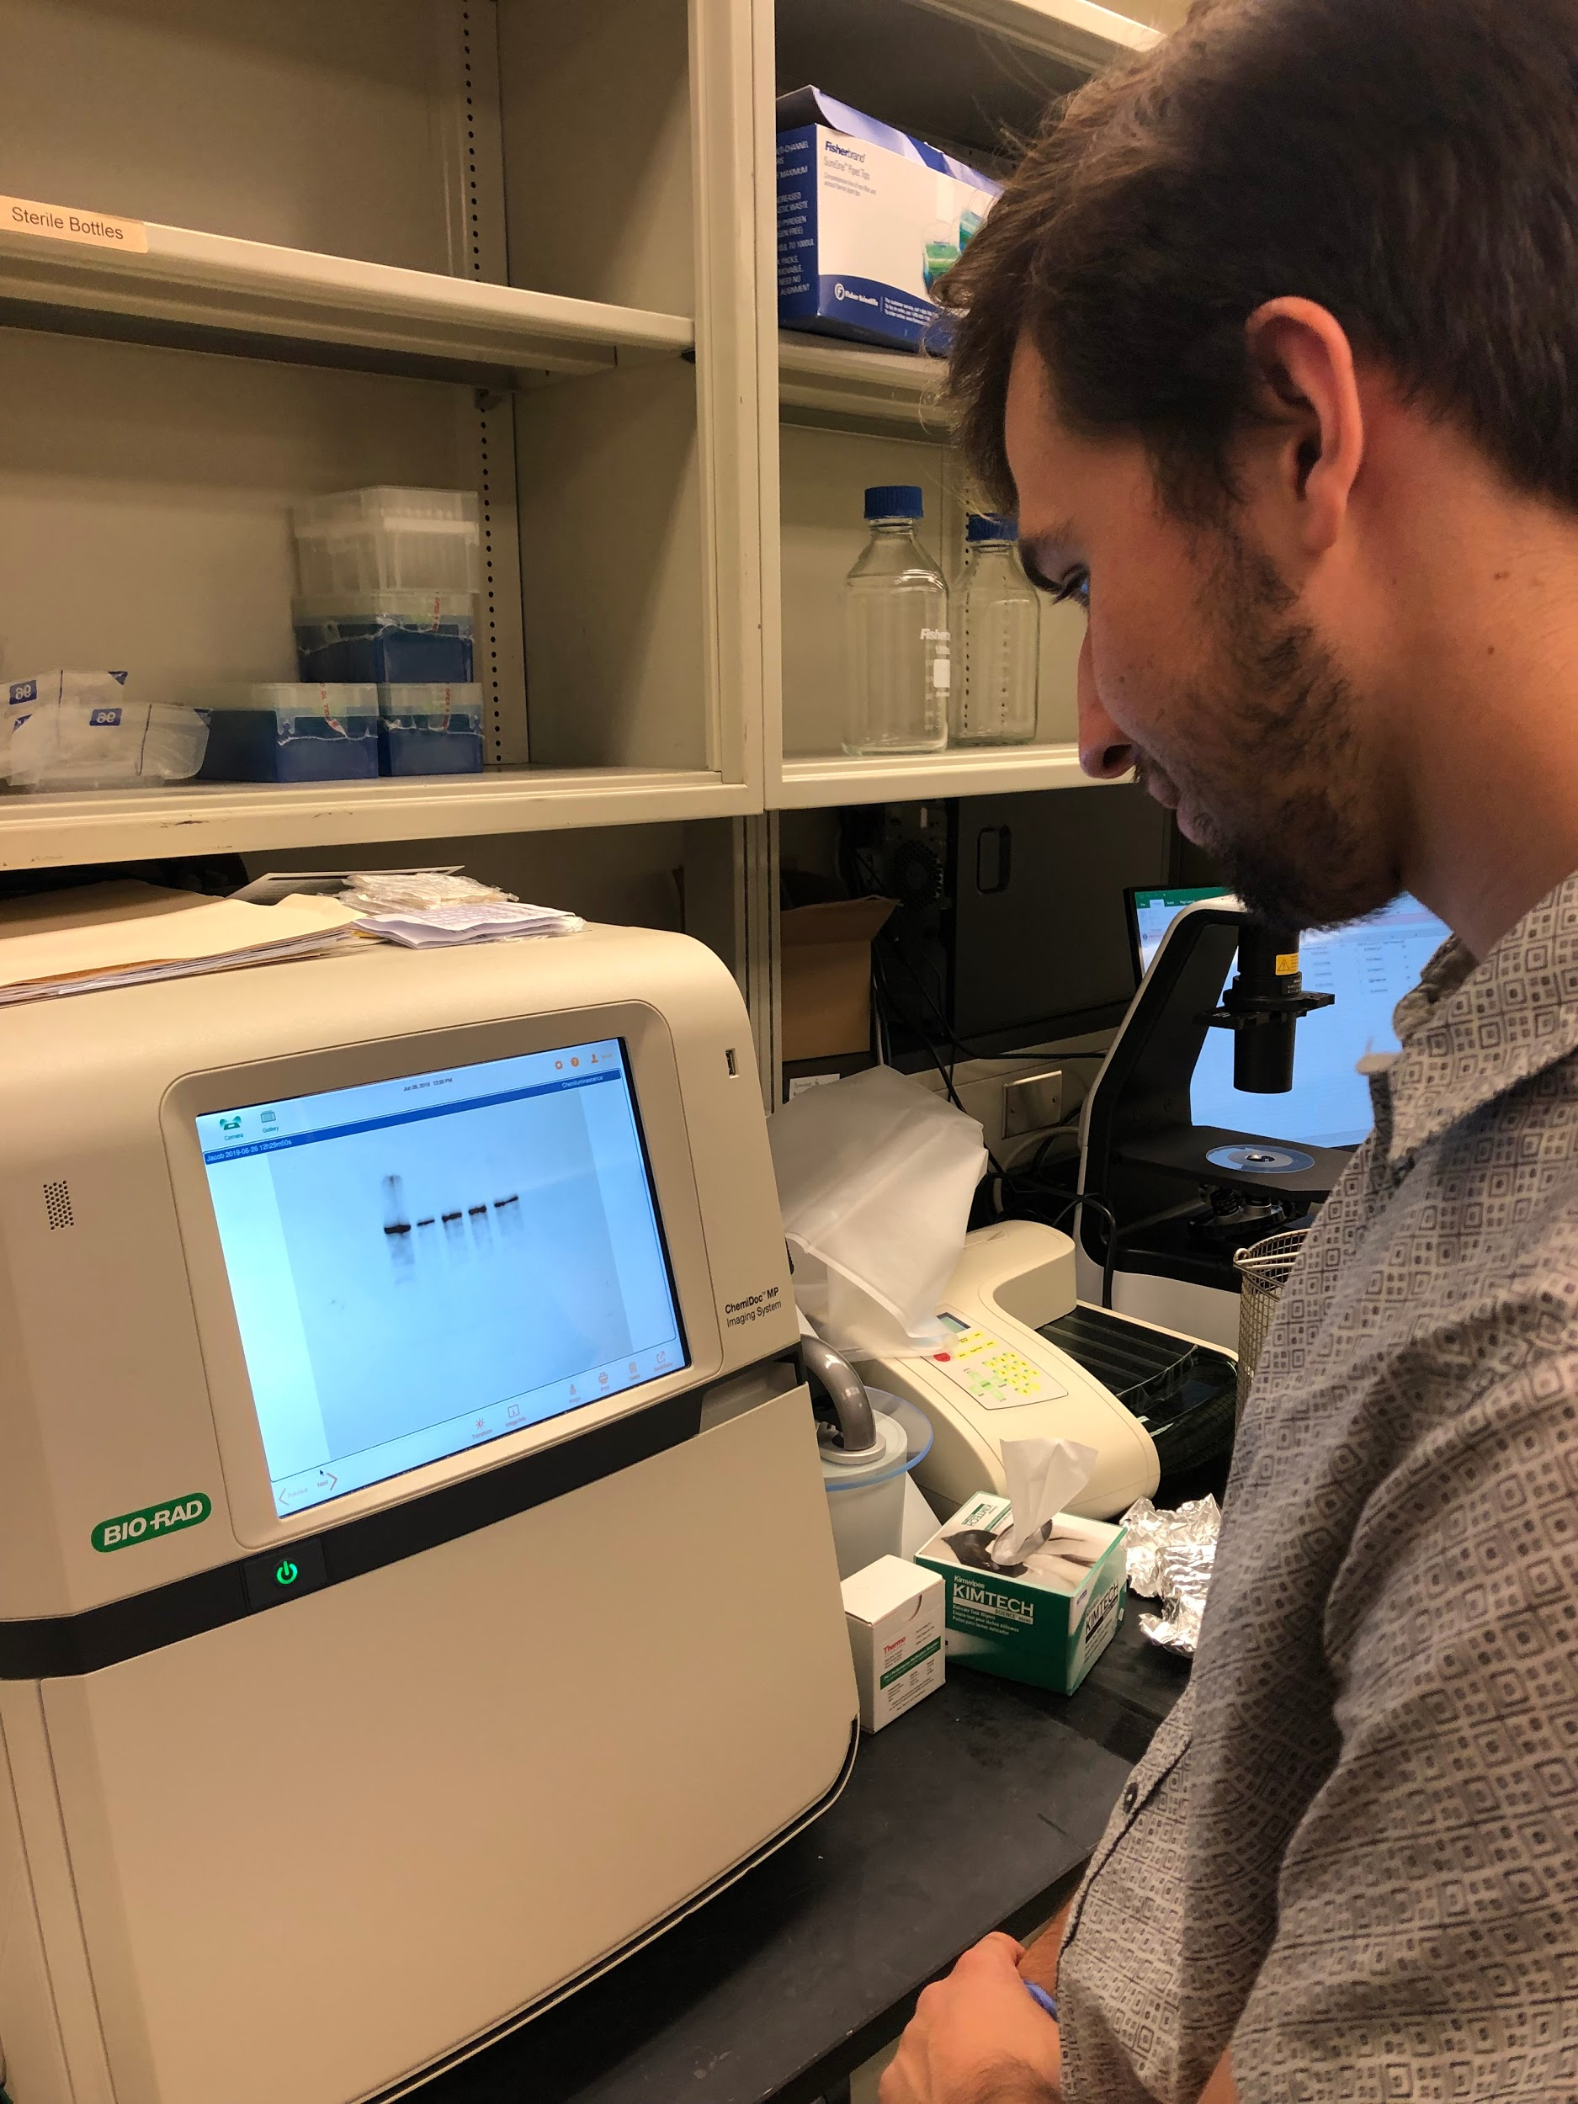
Training
Staining for DAPI/Actin/Fibronectin
Microscopy
Layering images for Phase/TRITC/DAPI
Alignment Quantification (ImageJ)
Western Blot Technique
Western Blot Quantification (Image Lab)
Cell Seeding, Cell mounting, and Decellularization
Electrospinning
Notes:
MB - label images more pictures

Slide 29
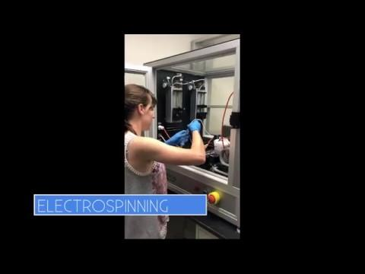
Voiceover Megan of training

Slide 30
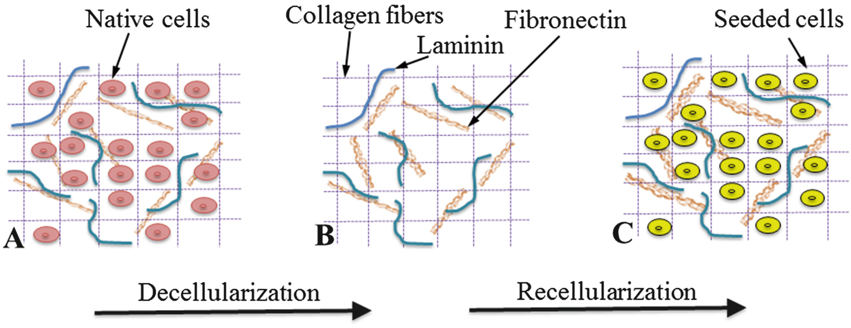
Why do we remove the cells?
Cells contain DNA that can cause an immune response leading to inflammation or rejection of the engineered tissue
Without the cells, the body doesn’t experience the adverse effects but still gains an optimal structure from the ECM.
Gupta, S.K., Mishra, C., Dhasmana, A. (2017). Decellularization methods for scaffold fabrication. Decellularized Scaffolds and Organogenesis, 1577.
Notes:
AV

Slide 31
Why do we remove the cells?
Cells contain DNA that can cause an immune response leading to inflammation or rejection of the engineered tissue
Without the cells, the body doesn’t experience the adverse effects but still gains an optimal structure from the ECM.
Gupta, S.K., Mishra, C., Dhasmana, A. (2017). Decellularization methods for scaffold fabrication. Decellularized Scaffolds and Organogenesis, 1577.
Notes:
AV

Slide 32
What is the role of scaffolds?
Steps 2+3: Spin the Scaffold
PVDF - piezoelectric, but solvent is toxic
Scaffolds provide a surface for cells to create an extracellular matrix (ECM) in a way that gives the cells alignment.
Alignment is important so that tissues keep their properties and regenerate faster.
Notes:
MB

Slide 33
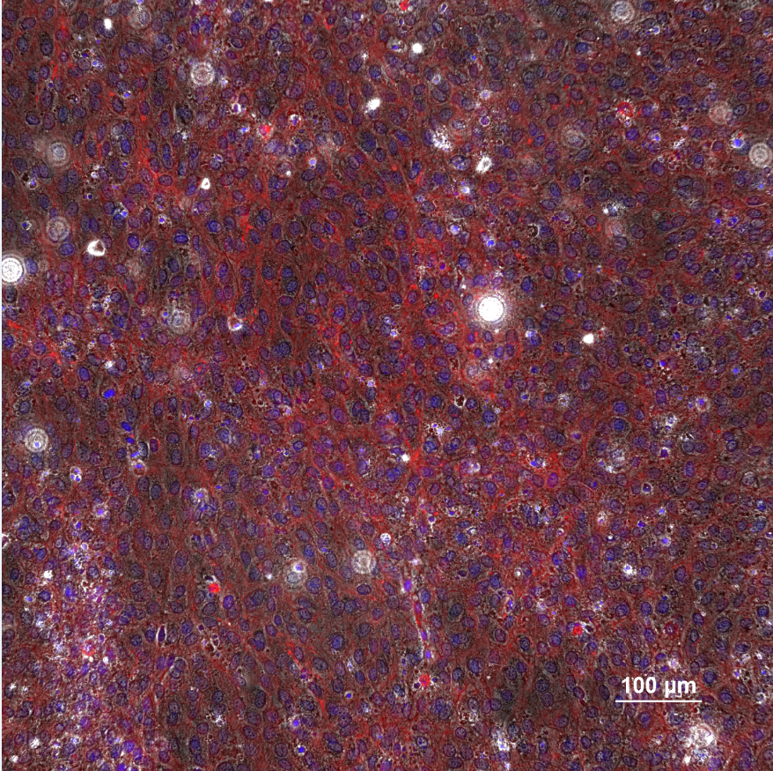
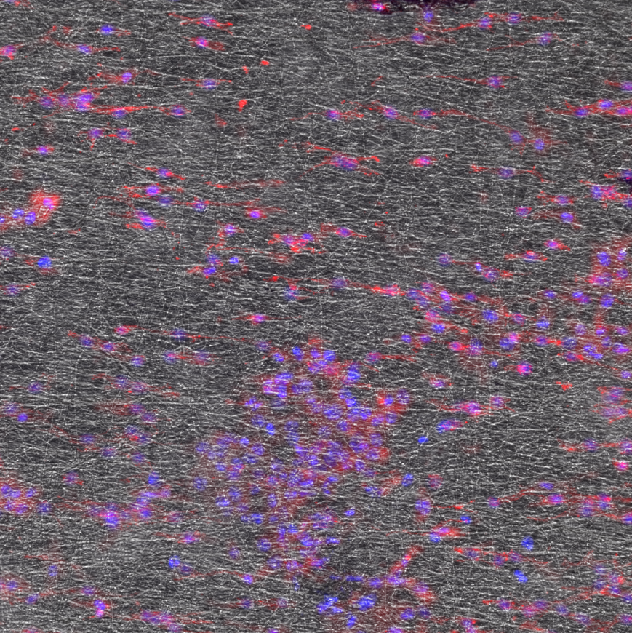
Un-Aligned Cells
(No Scaffold)
Aligned Cells
(With PVDF Scaffold)
Notes:
MB

Slide 34
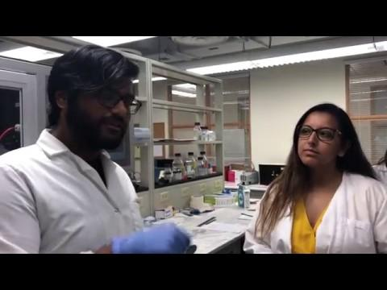

Slide 35
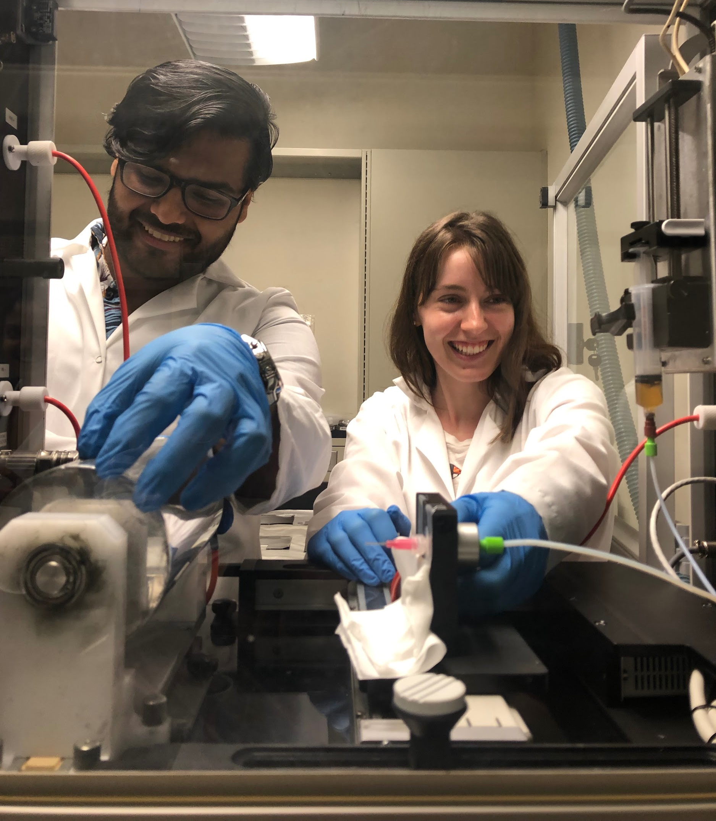
Minhaj and Anne on the electrospinning machine
PVDF sample

Slide 37
Research Methods
3
Where are we at in our research?

Slide 38
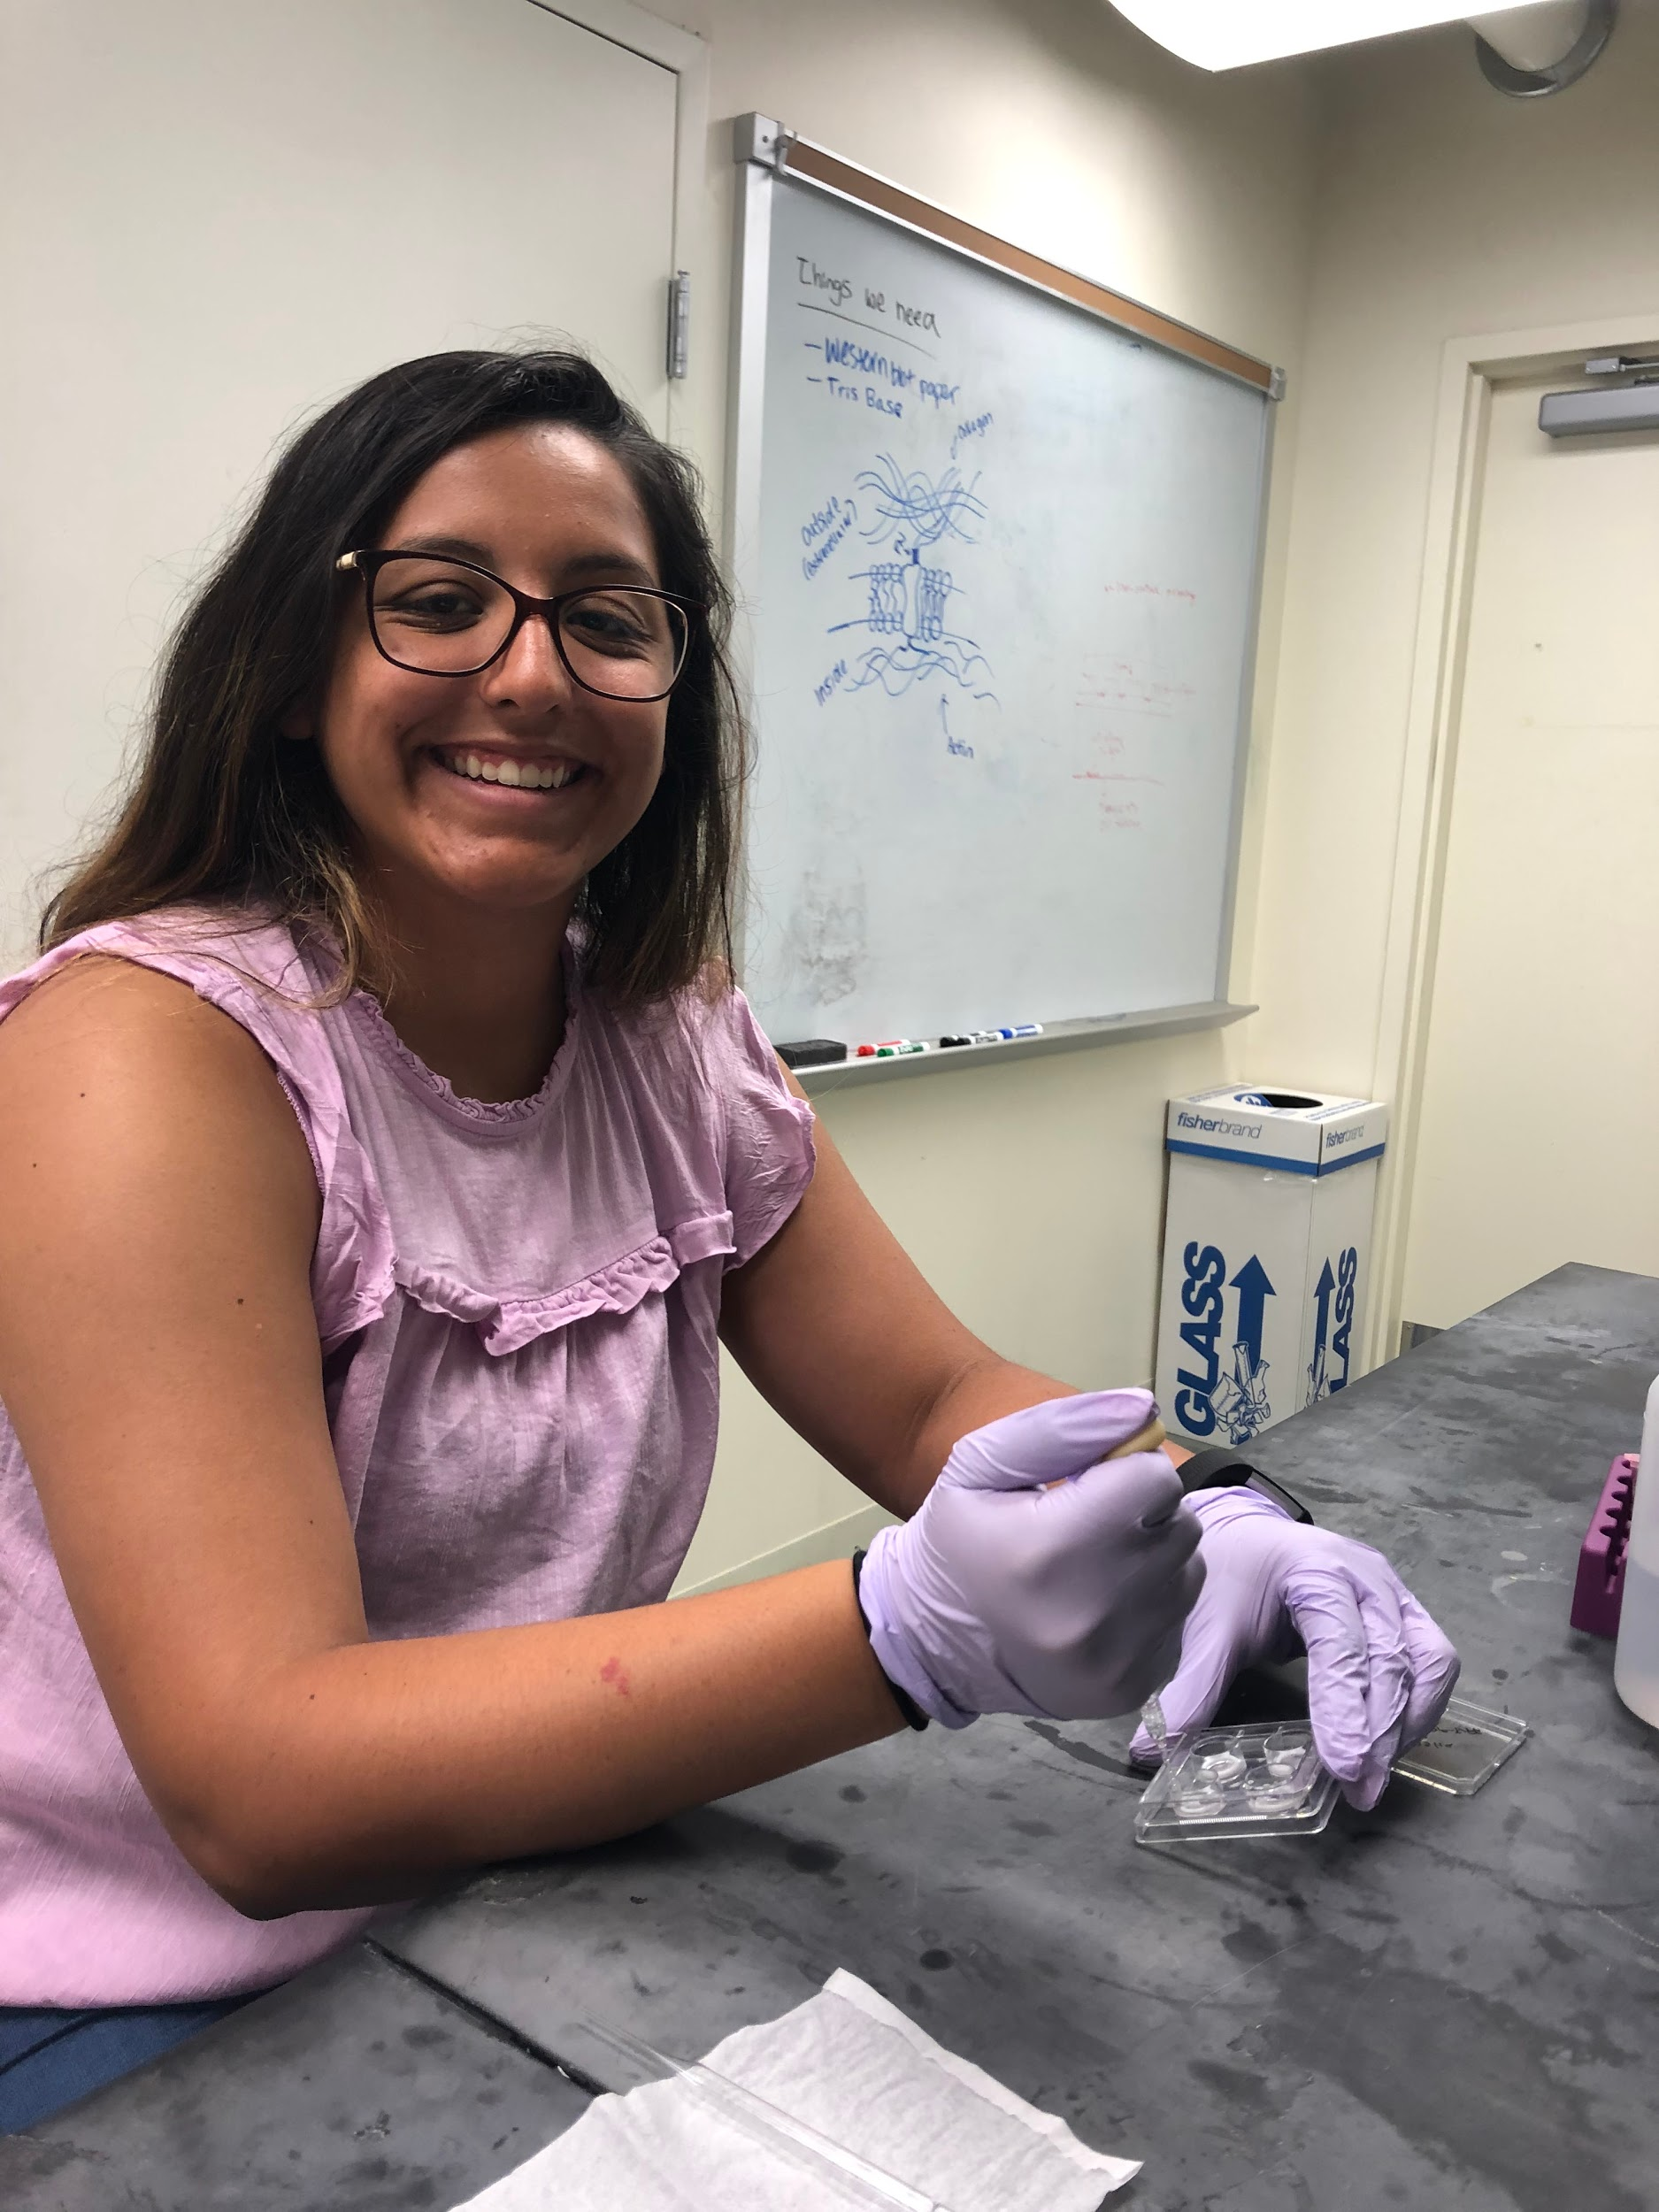
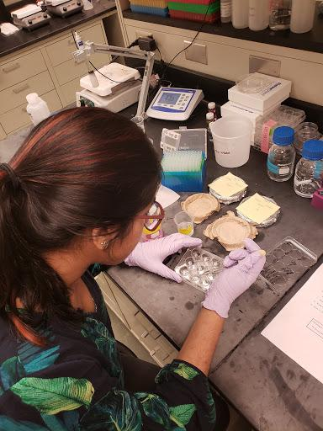
Step 4: Test
Collect data on 4 conditions:
unaligned polymer without extracellular matrix (control),
aligned polymer without extracellular matrix
aligned polymer with the extracellular matrix
extracellular matrix without polymer
Assess for cell alignment.
Notes:
AV - verify jacob

Slide 40
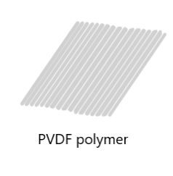
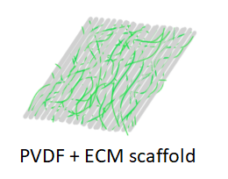
Overview of Conditions: ECM
Polymer w/ ECM
Polymer w/o ECM
Assessing for cell alignment

Slide 41
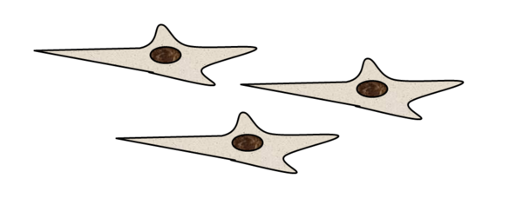
Overview of Conditions: Cell
3T3 Cells
Schwann cells
Assessing for cell growth and alignment

Slide 42
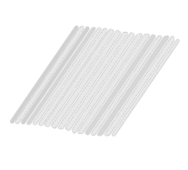
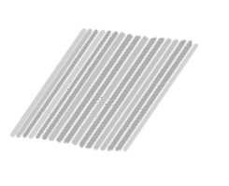
Overview of Conditions: Time
1 hour
2 hours
3 hours
Assessing for cell growth and alignment

Slide 43
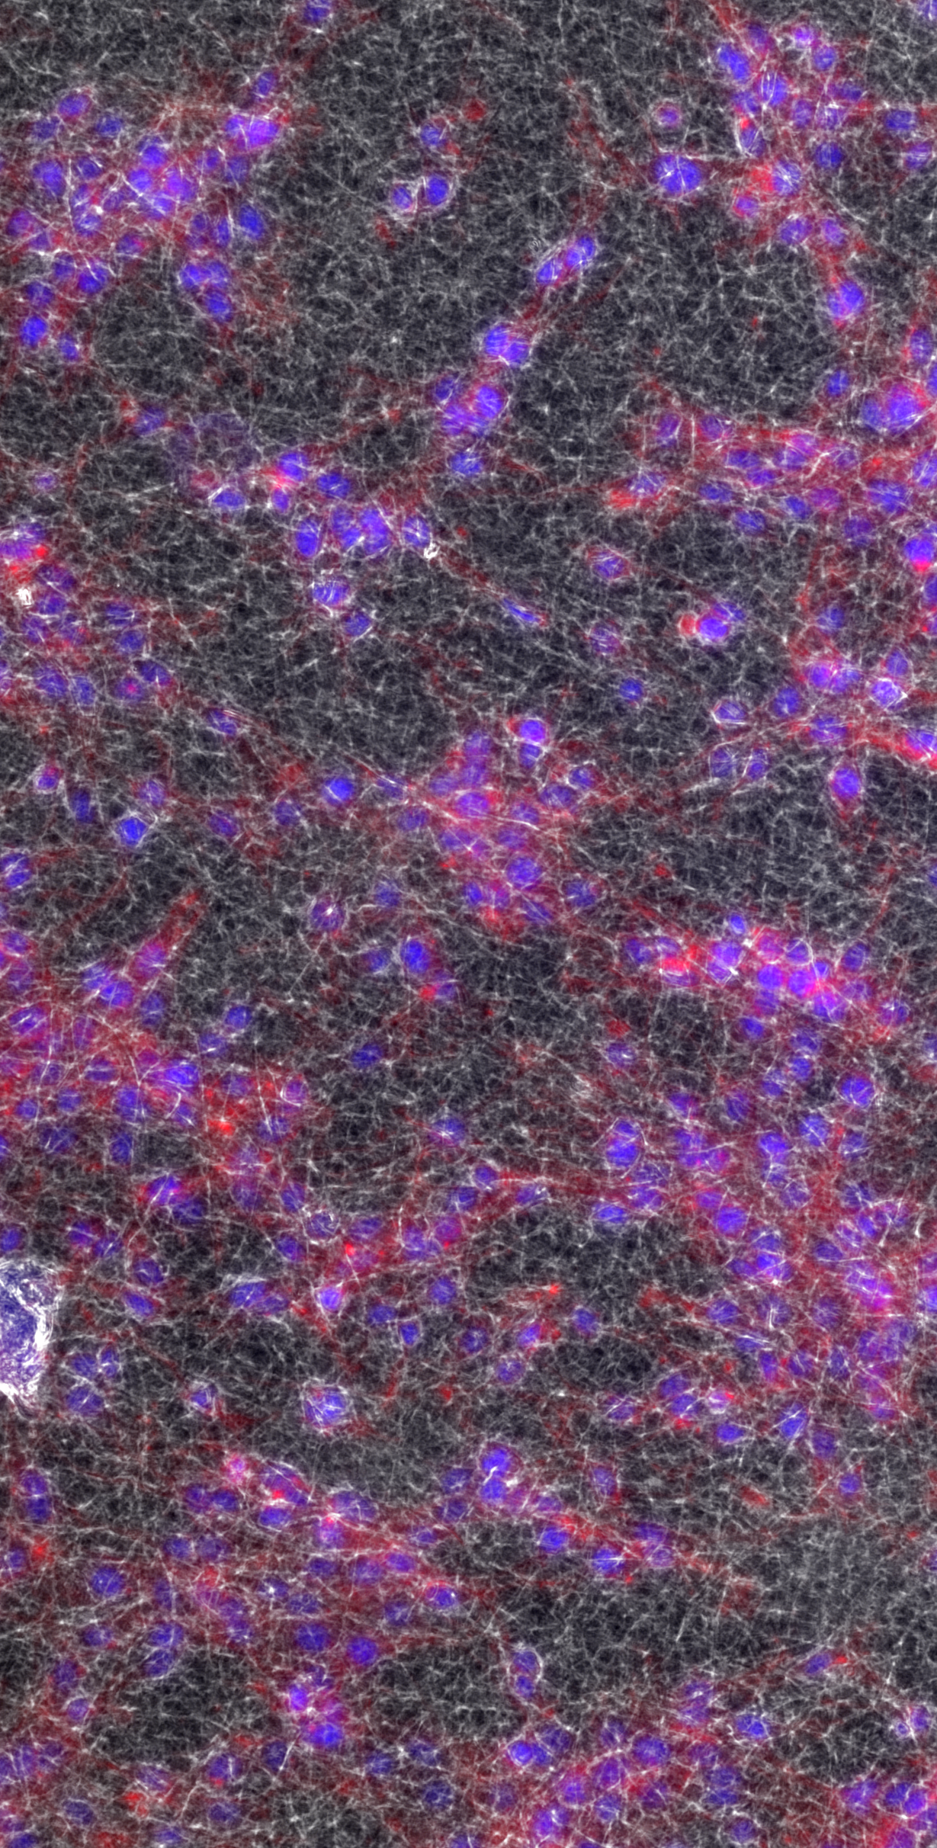
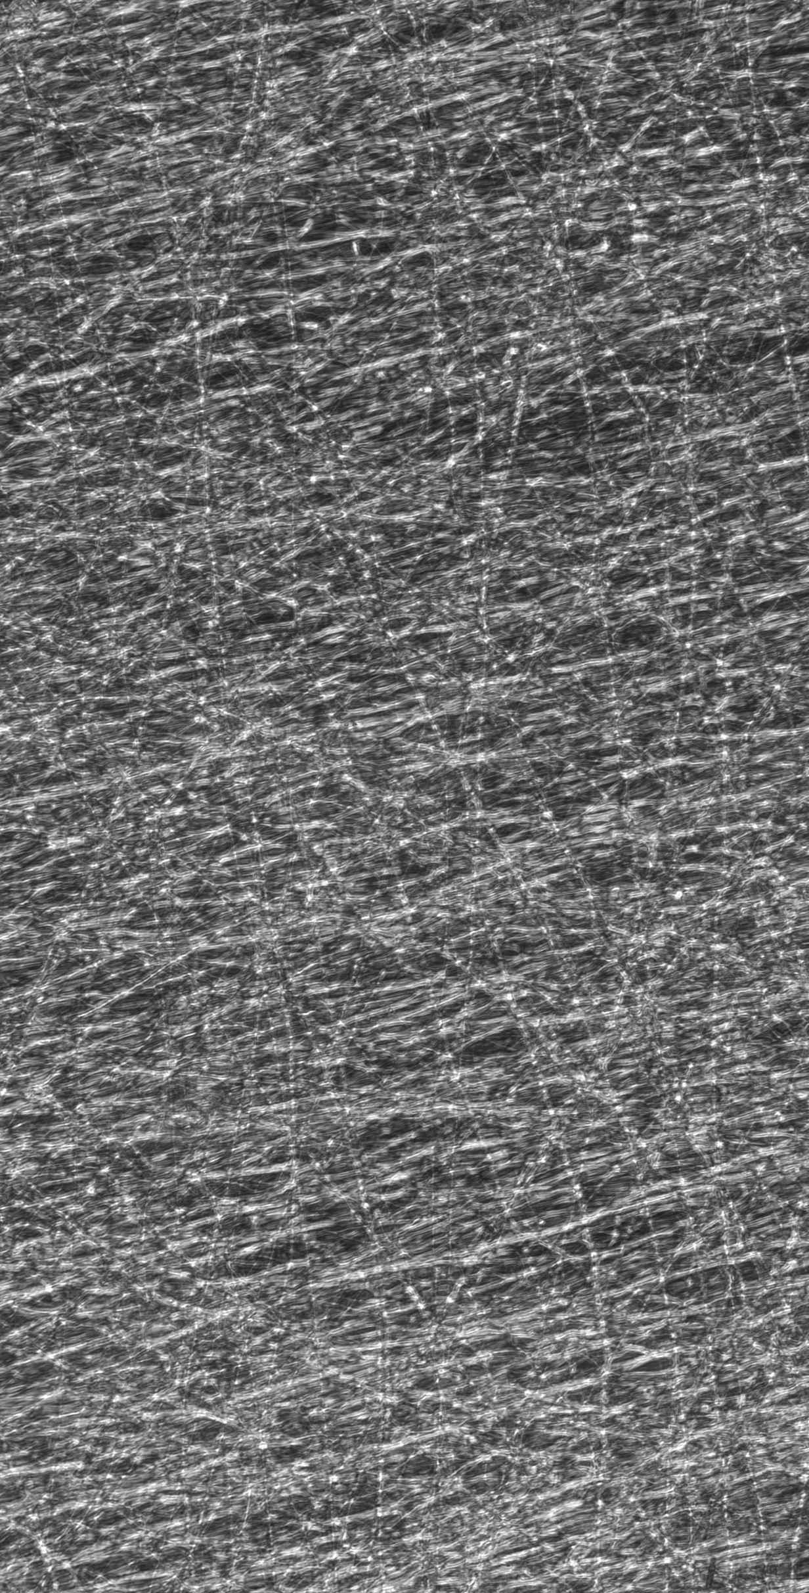
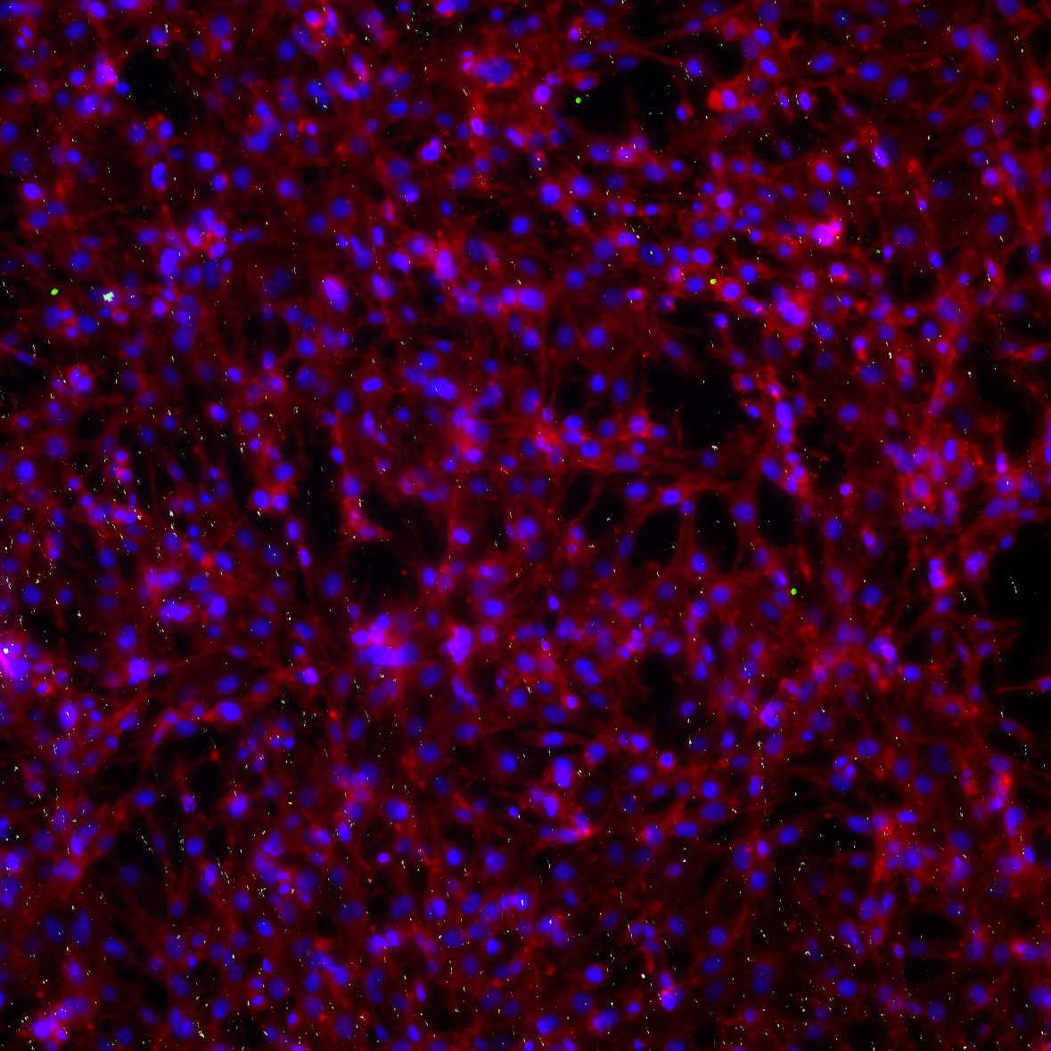
Step 4: Test
Unaligned Polymer
Aligned Polymer

Slide 44
Step 5: Analyze Results

Slide 45
Classroom Implementation Plans
4
How we plan to convert our knowledge from lab into classroom engagement

Slide 47
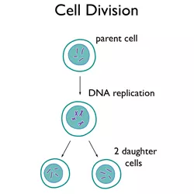
Classroom Presentation: Megan
Unit Topic: Mitosis and the Cell Cycle
Essential Question: What happens to the body in space?
Connection to Research: Optimizing cell growth for regeneration and healing.
ISCE Solutions for Class 10 Biology. (n.d.). Retrieved June 27, 2019, from https://www.aplustopper.com/cell-division-icse-solutions-class-10-biology/
NASA has no protocol for what to do with a dead body in space. (n.d.). Retrieved June 27, 2019, from https://curiosity.com/topics/nasa-has-no-protocol-for-what-to-do-with-a-dead-body-in-space-curiosity/
Notes:
Could my scale be used to test the bone density??
Need to discover how accurate.
Work on connection to research

Slide 48
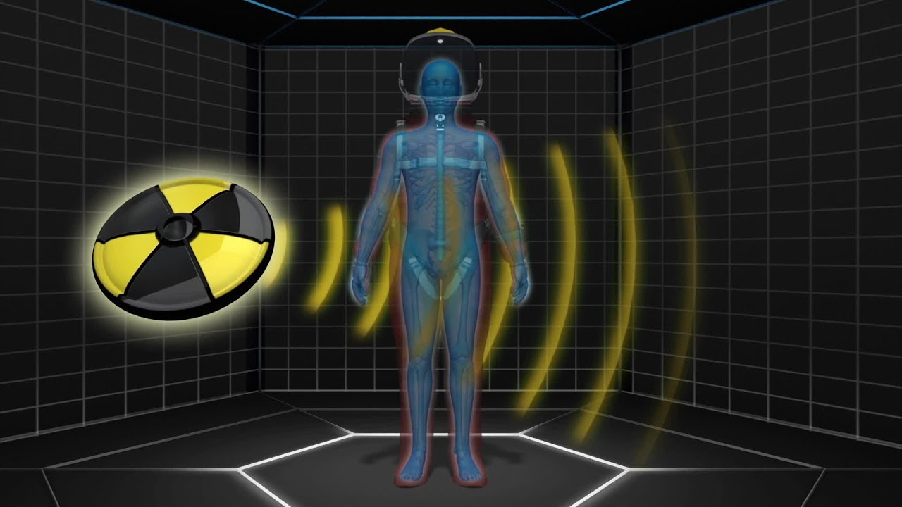
Classroom Presentation: Megan
Challenge: Students create a shield to allow yeast cells to continue proliferating under a UV light.
UV light simulates the constant radiation exposure astronauts will experience in space.
NASA investigates effects of space radiation (2017). Retrieved June 27, 2019, from https://www.youtube.com/watch?v=pltsq2UBzWk
Notes:
Could my scale be used to test the bone density??
Need to discover how accurate.
Work on connection to research

Slide 49
Activities: Megan
Activity 1: Onion Root Tip Lab
Activity 2: Engineering Mitosis
Activity 3: Radiation Stations
Activity 4: Challenge - Cellsavers

Slide 50
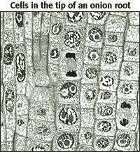
Activity 1: Onion Root Tip Lab
Objective:
Students will uncover cells dividing and be exposed to the process of cell division.
Leads students to begin to ask guiding/essential questions
Cells in the Tip of the Onion Root. (n.d.). Retrieved from http://www.biology.arizona.edu/cell_bio/activities/cell_cycle/cell_cycle.html (Originally photographed 2004, April)

Slide 51
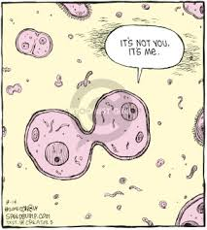
Activity 2: “Let’s Make like a Cell and SPLIT!”
Objectives:
Students will determine the steps that occur during mitosis by figuring out the “problems” a cell may encounter while undergoing mitosis
Students will model solutions to these problems the cell faces.
Coverly, D. (2008, August 14). Speed Bump [Cartoon]. Retrieved from http://www.thecomicstrips.com/store/add.php?iid=25868

Slide 52
Activity 3: Radiation Stations
Objective:
Students will be able to describe what radiation is, how it forms, and how it impacts human bodies.
Exposure to articles, YouTube videos, modeling stations, etc… will allow students to start to put the pieces together in order for them to “create” the desired challenge.

Slide 53
Activity 4: Cellsavers
Objectives:
Students will identify radiation as a critical issue to overcome before long term space flight occurs.
Students will then create a shield out of different materials that could help yeast cells survive and proliferate.

Slide 54
Classroom Presentation: Akshayaa
Unit Topic: Homeostasis and Feedback
Essential Question: Why do certain diseases cause pain? How can that pain be relieved?
Connection to Research: Biocompatible scaffolds could aid in nerve regeneration, and nerves regulate body function and communication.
Biomaterials for nerve regeneration (2009). Retrieved June 27, 2019, from http://chen2820.pbworks.com/w/page/11951452/Biomaterials%20for%20nerve%20regeneration
Notes:
AV

Slide 55
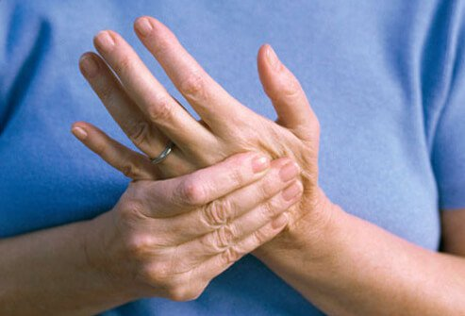
Classroom Presentation: Akshayaa
Connection to Research: Wound healing starts with homeostasis. Biocompatible scaffolds can aid in nerve regeneration, and nerves regulate body function and communication.
Challenge: Students will design and test a product or plan for patients with different conditions that cause pain.
NERVE pain (2016). Retrieved June 27, 2019, from https://www.rxlist.com/nerve_pain_slideshow/article.htmh
Notes:
AV

Slide 56
Activities: Akshayaa
Ouch! Why did that hurt?
Planaria Experiment
Data Collection and Research
Let’s DTEC a Solution - Design, Test, Evaluate, Communicate!

Slide 57
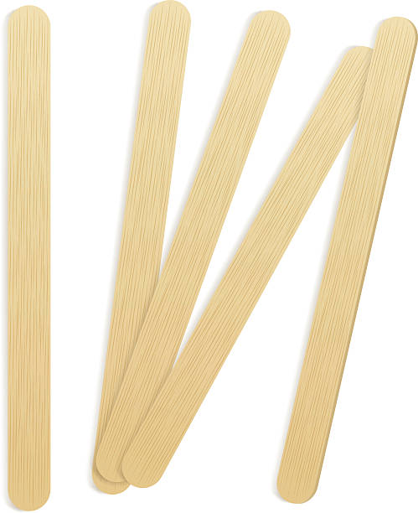
Activity 1: Ouch! Why did that hurt?
Students will be able to:
• Identify the role of feedback loops perception of pain.
• Describe in writing conditions that affect nerve sensation and causes pain by evaluating scenarios in pairs.
Feedback loops in nature (2016). TED Ed. Retrieved 10 July 2019 from https://ed.ted.com/lessons/feedback-loops-how-nature-gets-its-rhythms-anje-margriet-neutel.

Slide 58
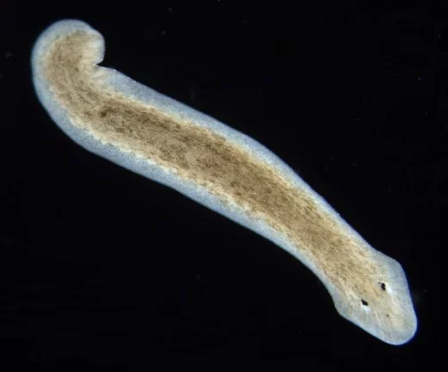
Activity 2: The Planaria Experiment
Students will be able to:
• Develop a hypothesis on how the planarians will respond to different stimuli in their environment (light, chemicals, temperature, sound, etc.)
• Carry out an experiment and collect data in data table.
Planarians and Regeneration: Facts and Recent Discoveries (2018). Retrieved 10 July 2019 from https://owlcation.com/stem/Planarians-and-Regeneration-Facts-and-Recent-Discoveries.

Slide 59
Activity 3: Why does that hurt? - Data Collection and Research
SWBAT:
• Identify a client and research the needs and backgrounds of their client’s condition and pain.
• Research a condition to identify how the disease or condition causes symptoms of pain.
• Brainstorm current solutions and identify cost-effective, sustainable alternatives that meet the needs of their client.
NERVE pain (2016). Retrieved June 27, 2019, from https://www.rxlist.com/nerve_pain_slideshow/article.htmh

Slide 60
Activity 4: Let’s DTEC a Solution - Design, Test, Evaluate, Communicate!
SWBAT:
• Simulate the conditions of pain to evaluate the effectiveness of their product or process.
• Iterate and improve their product or process and reflect on changes to maximize effectiveness.
• Communicate their findings and model their product or process to their peers.

Slide 61
Special Thanks!
Dr. Greg Harris and Dr. Leyla Esfandiari
Lora Buchanan and Dr. Margaret Kupferle
Pamela Truesdell and RET Presenters
Jacob Orkwis and Emmy Cady
Ann Wolf and Minhaj Shahid
RET 2019-20 Participants
NSF
RET is funded by the National Science Foundation, grant # EEC-1710826
University of Cincinnati

Slide 62
Questions?
Notes:
MB more questions

